Slide 1



Ch. 3: Visions for a Democratic Future
Nathan P. Kalmoe
University of Wisconsin – Madison
Chicago occupies ancestral lands of the 3 Fires—Ojibwe, Odawa, & Potawatomi—as well as the historic lands of the Ho-Chunk, Menominee, & Miami.

Slide 2
Acknowledging dark times in a new regime
Republicans dismantling American democracy (such as it was)
  Extorting law firms, businesses, universities, states, & electeds to abandon equity & serve the Trump admin
  Deporting & detaining people for speech & w/o due process
  Sending people to foreign slave camps
  Direct violations of constitutional provisions
  Defying court injunctions
  Trump’s royal assertions that he was chosen by God to save America, literally to be dictator
  Undoing 1960-70s Civil Rights revolution by race, sex, class, religion
Obviously bleak, but still chances for even short-term wins

Slide 3
America wasn’t a great democracy before
Even before Trump’s 1st term, US fell way short on democratic requirements of equal say & equal rights
Unpopular elections for Pres, Senate, House→ unpopular courts
State-level gerrymandering, removing leader powers when Dems win
Many millions of Americans w/o vote rights & no representation in fed gov’t
Barriers to voting that make US participation among the lowest
Parties & elections distorted by unrestricted campaign spending
Systematic discrimination throughout gov’t & society for marginalized groups by race, gender, class, religion, disability, nationality, & more

Slide 4
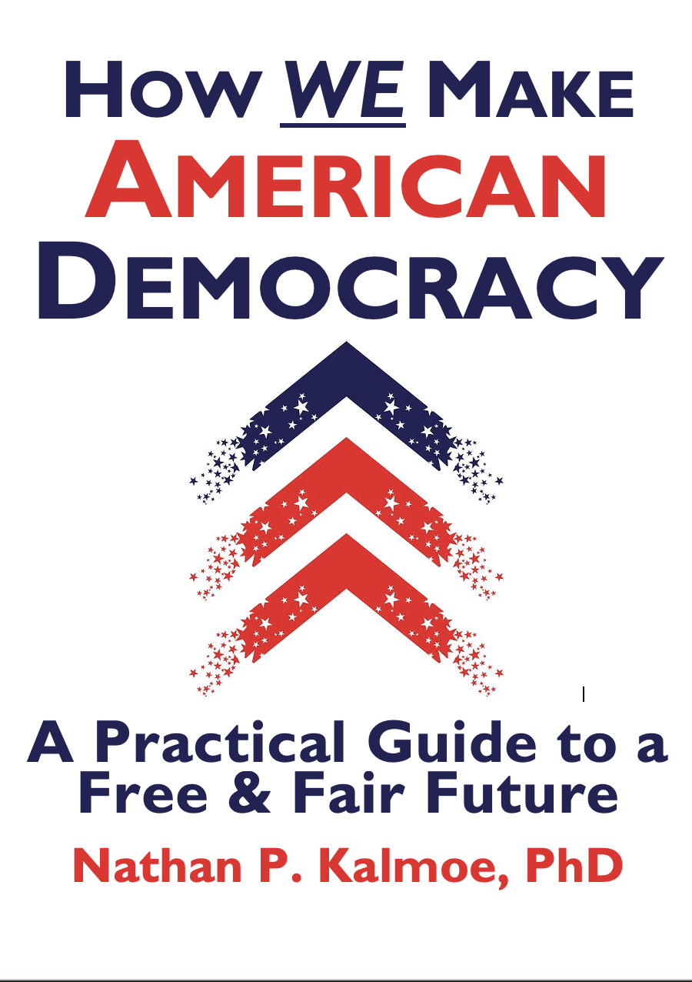
The broader book project
Introduction: Imagining democracy in America
Part 1: Ideals, problems, & solutions
1. America’s democratic ideals versus hegemony
2. How America falls short on democracy
3. Visions for a democratic future
Part 2: Common paths from inequity to justice
4. Milestones for change (& how to reach them)
5. America’s democracy movements & their entrenched adversaries
6. Democratizing parties & publics
Part 3: How we make better political cultures
7. Cultivating cultures of care, empathy, & equity
8. Democratizing education & civic institutions
9. Building news systems to inform & empower publics
Part 4: How we make better political institutions
10. Making governments representative of the people
11. Ensuring governments of, by, and for the people
12. Making “more and better political parties”
Part 5: How we make policies for a better future
13. Ensuring public safety
14. Guaranteeing bodily autonomy
15. Meeting basic needs for everyone
Conclusions, continuations, & new beginnings: Democracy is what we do
2026/2027

Slide 5
Book goals
Affirm better frameworks for understanding 250 years of American politics: marginalized groups trying to get = from dominant ones
  better social science AND more effective democratization efforts
Clarify what democracy is & how the US falls short of ideals
Highlight dozens of successful US democratizing movements
  inspiration & process insights
Draw on diverse experts & ordinary people to imagine what American democracy could be – not just marginal change
  agenda proposals for change, inspires more imagination
Set out a changemaking roadmap to help ppl see the full process
  helps planning, strategizing, and understanding
Synthesize practical expertise on strategies & tactics for effective changemaking from scholars & practitioners, from local to national, from movement goal-setting to bureaucratic implementation.

Slide 6
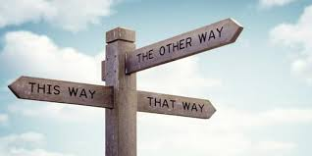
Where we’re headed…
Imagining better
Expert interviews
Inputs
Mechanisms
Outputs
Conclusions

Slide 7
Imagining better
Incremental planning & change is essential, but long-term, imaginative visions are too
Movements driven by hope & determination laid groundwork for many of the biggest democratizing moments in US history over decades, without a certain path to success
They MADE the path, were prepped to act when brief windows opened
Imagination also reaffirms our core democratic values, and acknowledges that our status quo is NOT OK

Slide 8
Expert interviews
150→180 interviews: scholars, practitioners, activists, civic leaders
Feb 2024 – present
Chosen for knowledge of specific areas of change processes
Over half women, over 40% PoC
Mostly centrist to left, only a few Republicans, lots non-partisan
Broader project includes representative public surveys on visions, plus practitioner surveys

Slide 9
A snapshot of interviewees
Scholars: PoliSci, Edu, Psyc, History, Soc, Gender/Race, Comm, Law, Policy, Philosophy…
Senior policy advisor to a Dem governor
Local Urban League president
Editor of a nat’l Native American newspaper
HR exec at a major aerospace company
Washington Post columnist
Deputy mayor of a mid-sized city
Local teachers’ union president
AFL-CIO presidential adviser
Ad director for major SuperPAC
Major Democratic donor
Head of Freedom House
US House candidate
Ex-White House counsel
State-level union political director
Program officers for private & gov’t grant orgs
Fiction author
Tech entrepreneur
AP politics reporter
Small biz owner
Liberal Catholic deacon
Local TV anchor
Musicians
School food program consultant
School superintendent
Brookings scholar
Community organizers

Slide 10
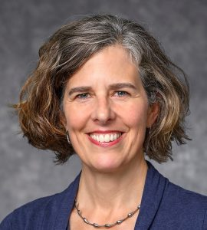
The question (h/t Kathy Cramer)…
“If you had a magic wand and could change ONE thing about the American political system or our politics, at any level, what would it be, and why?”

Slide 11
The most common responses…
More parties/PR
Popular vote for President
Easier voting & other participation
Abolish the Senate
Money out of politics
Weaker, more representative courts
Improved information environment
Egalitarian political culture, equal voice, empathy
Knowledgeable, empowered citizens
Basic needs met for everyone

Slide 12
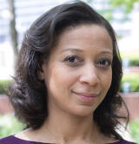
Inputs to democracy
Psychologist Jennifer Richeson:
“I don't know how to say this, because it sounds like brainwashing, and I don't mean it in that way, but I would shift people's orientations toward embracing the promise of a multiracial, multi-ethnic, religiously pluralistic democracy, small d democracy. To really embrace that as not just possible, but valuable, and certainly to assuage concerns and feelings of unease that appear to be connected to that kind of vision. Maybe that's too big a wand. Maybe the smaller wand is articulating a vision of that that people might find compelling. But yeah, the big wand is actually whatever fairy dust falls and people come to a sense of peace about that – not just for our nation but in general – and it being something that seems not scary and maybe sort of exciting.”

Slide 13
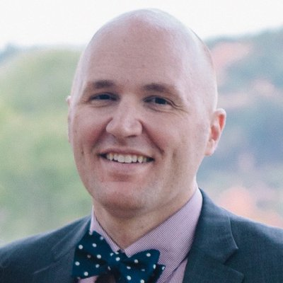
Mechanisms of democracy
Political scientist Daniel Magleby:
“If I could change one thing, I would abolish the Senate. One reason is that the redundancy of multiple chambers in Congress has proven to be less important to maintaining democracy and making progress than the Founders seemed to understand. But also: the Senate is constructed in a way that is fundamentally undemocratic, and it has acted consistently in undemocratic ways throughout history. And that is a problem for progress and for continuing to maintain a legitimate government in the United States.”

Slide 14
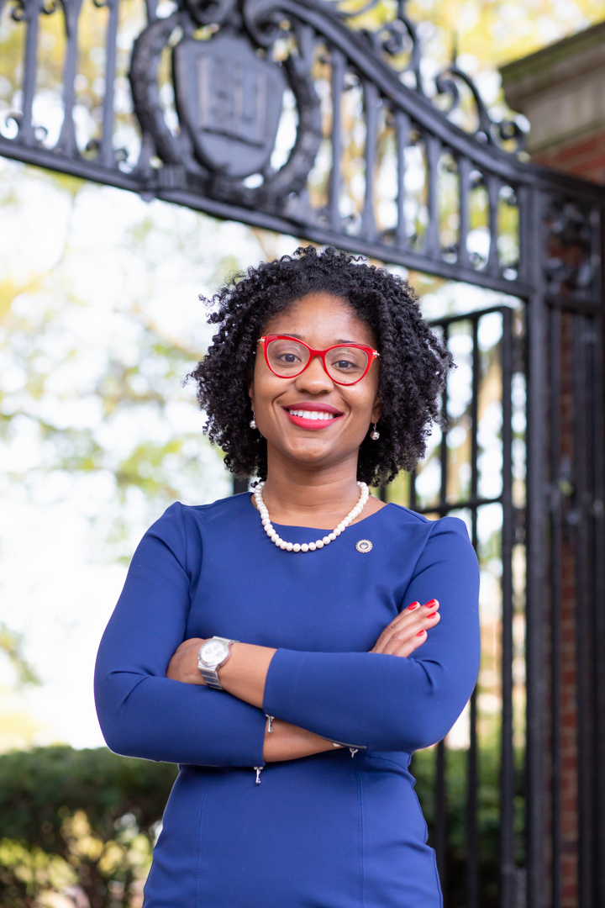
Outputs (& inputs) of democracy
Political scientist Keneshia Grant:
“There must be a better floor in American life – a higher baseline for education, for the basic needs of people being met, etc. I don't think we can get to the political life that we want – the one that works well – if people are not doing well. But in our current configuration, for people to do be doing well, some people are going to have to share things, even if the sharing never gets to be equal or equitable.”

Slide 15
Conclusions
Visions for what American democracy could & should be
Useful as an exercise in agenda-setting, & an inspiration for further civic imagination
Next steps:
Incorporate public visions & polls on these ideas
Write the book
We all work to make our visions a reality

Slide 16
Some other innovative thinking…
Everyone can unionize their workplace w/ a majority vote
Sortition
Make political geographies match ecological systems
City-based representation in the Senate
Tie 2nd Amendment explicitly to military organization
Ending social-political homophily
Make enduring majorities, like Dems in mid/late-20th century
New local participatory infrastructure
End capitalism
Nat’l devolution to states & tribes
Fewer veto points
Change K-12 civics & US history curriculum
A shared sense of having a common country, a shared polity

